Slide 1
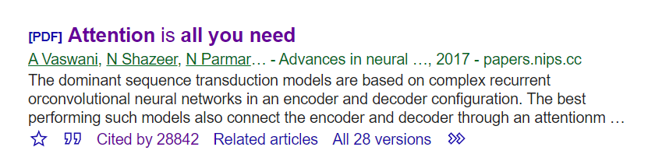





Attention!! Attention!!
Is All You Need*
Igor Kotenkov
@stm
Paper: arxiv.org/abs/1706.03762
Pictures: jalammar.github.io

Slide 2
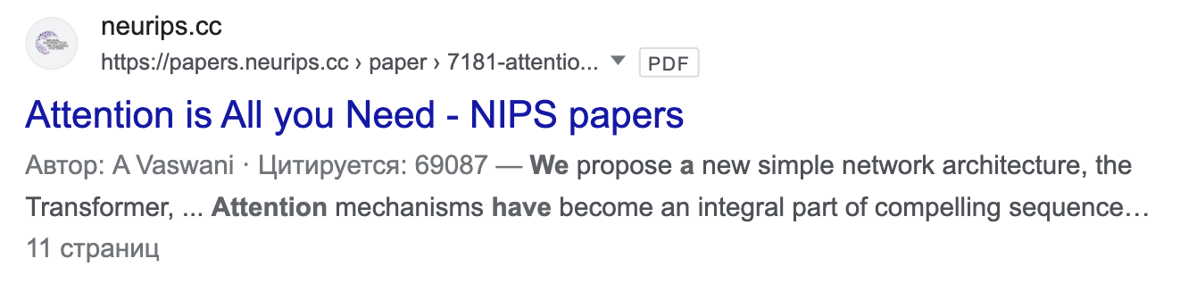
Attention!! Attention!!
Is All You Need*
Igor Kotenkov
@stm
Paper: arxiv.org/abs/1706.03762
Pictures: jalammar.github.io

Slide 3
Here's our plan...
NLP 101
Text Representation and Tokenization

Slide 4
Here's our plan...
NLP 101
Text Representation and Tokenization
Transformer Architecture Overview
Feed Forward Module
Self-Attention Module
Other Important parts
Encoder VS Decoder Comparison

Slide 5
Here's our plan...
NLP 101
Text Representation and Tokenization
Transformer Architecture Overview
Feed Forward Module
Self-Attention Module
Other Important parts
Encoder VS Decoder Comparison
Transformer Training Details

Slide 6
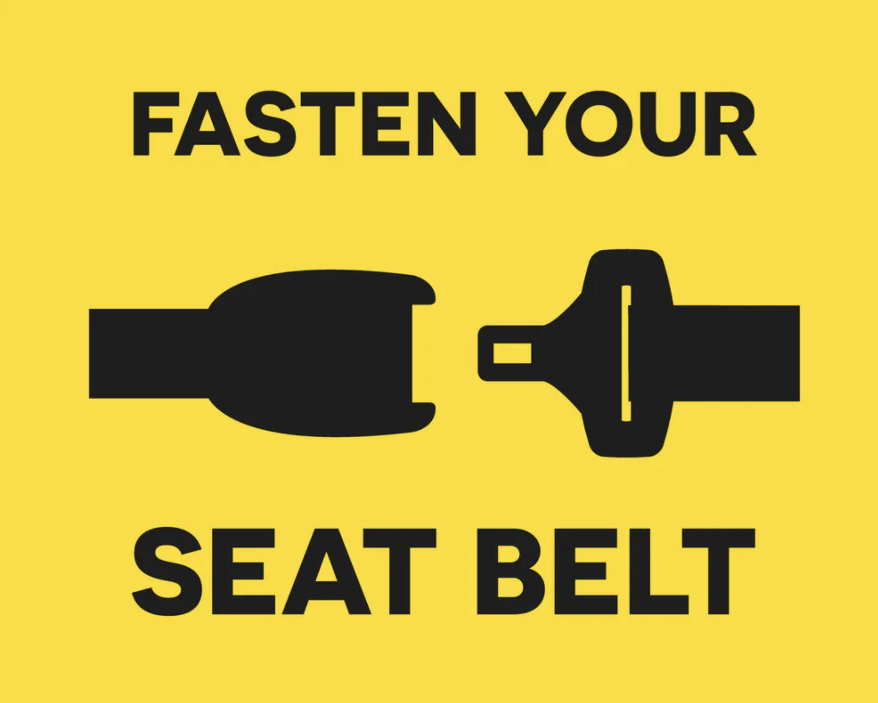


Slide 7
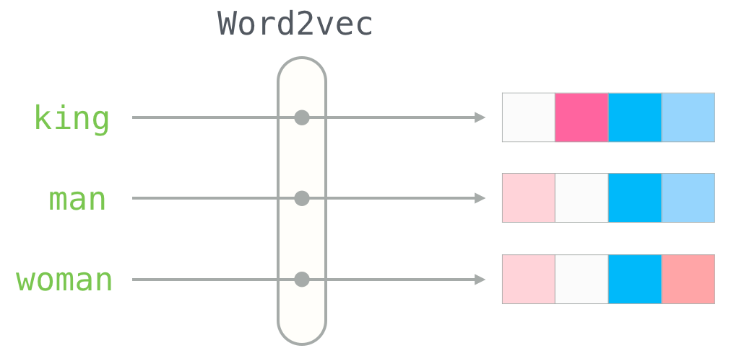
NLP 101
Needs some preprocessing:
Remove puctuation and special symbols (incl. Contractions)
Do something with numbers
Check / correct spelling
Stemming (single word) and Lemmatization (with context)

Slide 8
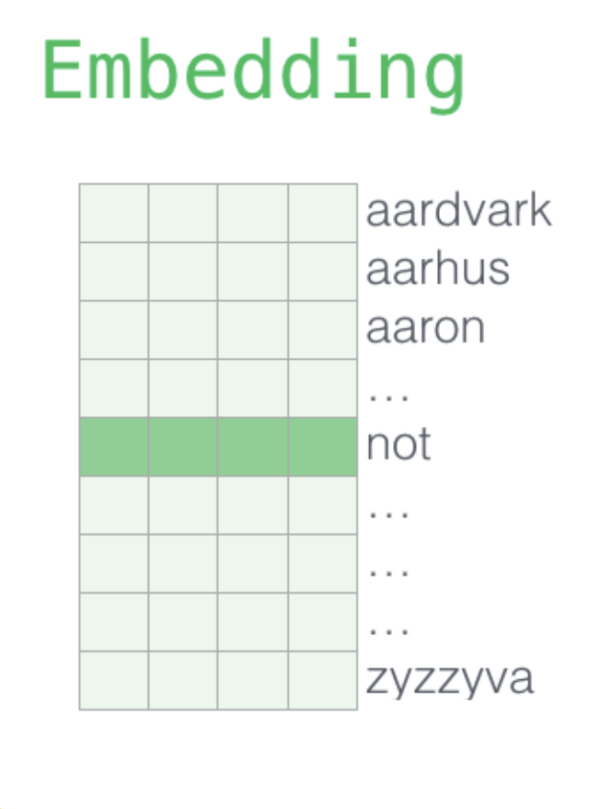
NLP 101
Needs some preprocessing:
Remove puctuation and special symbols (incl. Contractions)
Do something with numbers
Check / correct spelling
Stemming (single word) and Lemmatization (with context)
1
2
3
…
6
…
…
…
N
height = vocab size
(one row for each word)
width = embedding dimension

Slide 9

NLP 101
Needs some preprocessing:
Remove puctuation and special symbols (incl. Contractions)
Do something with numbers
Check / correct spelling
Stemming (single word) and Lemmatization (with context)
1
2
3
…
6
…
…
…
N
height = vocab size
(one row for each word)
width = embedding dimension

Slide 10
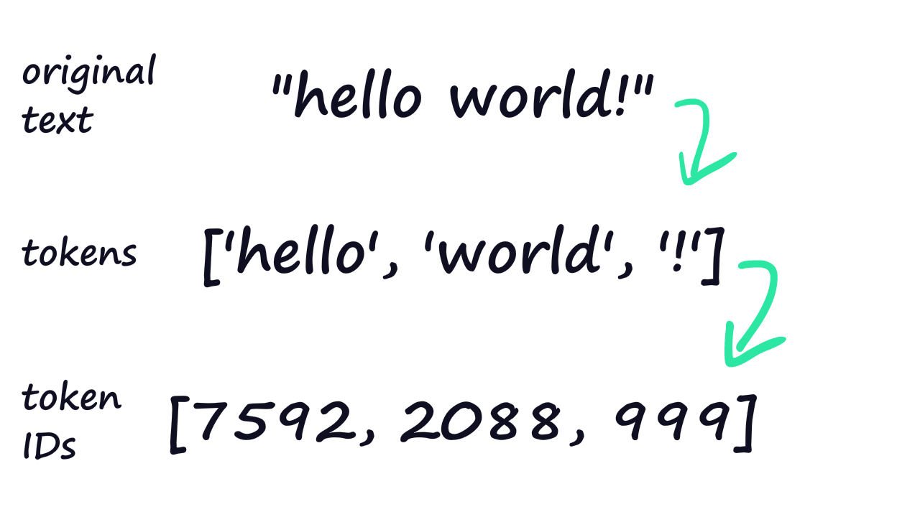
NLP 101
1
2
3
…
6
…
…
…
N
height = vocab size
(one row for each word)
width = embedding dimension

Slide 11
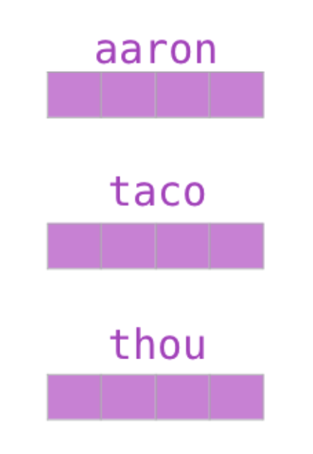
NLP 101
1
2
3
…
6
…
…
…
N
height = vocab size
(one row for each word)
width = embedding dimension

Slide 12
NLP 101
1
2
3
…
6
…
…
…
N
height = vocab size
(one row for each word)
width = embedding dimension

Slide 13
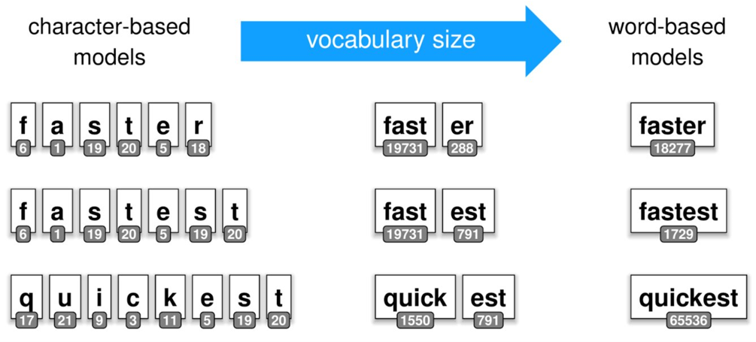
Text Representation
From individual symbols...

Slide 14
Text Representation
From individual symbols, whole words...

Slide 15
Text Representation
From individual symbols, whole words and N-grams– to most common co-occurrences

Slide 16
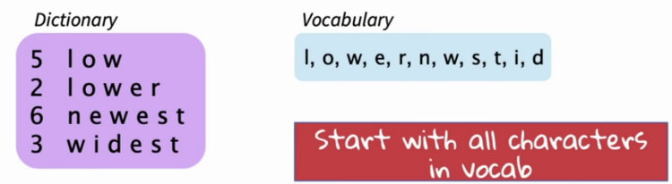
Text Representation
From individual symbols, whole words and N-grams– to most common co-occurrences
To build a tokenizer vocabulary:
Initialize a vocabulary with all unique symbols from a dataset

Slide 17
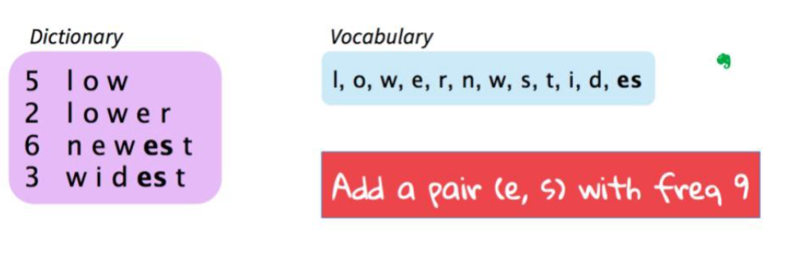
Text Representation
From individual symbols, whole words and N-grams– to most common co-occurrences
To build a tokenizer vocabulary:
Initialize a vocabulary with all unique symbols from a dataset
Build a character co-occurrences model
Pick the most common pair

Slide 18
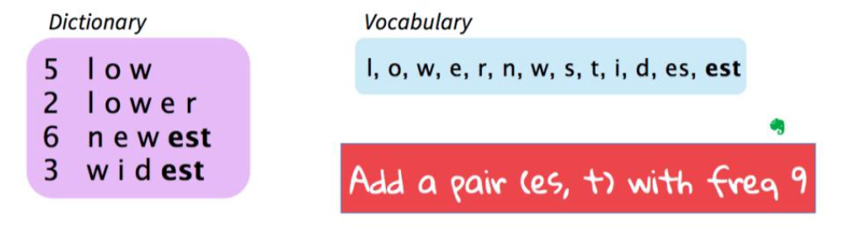
Text Representation
From individual symbols, whole words and N-grams– to most common co-occurrences
To build a tokenizer vocabulary:
Initialize a vocabulary with all unique symbols from a dataset
Build a character co-occurrences model
Pick the most common pair
Repeat...

Slide 19
Text Representation
From individual symbols, whole words and N-grams– to most common co-occurrences
To build a tokenizer vocabulary:
Initialize a vocabulary with all unique symbols from a dataset
Build a character co-occurrences model
Pick the most common pair
Repeat...until you reach the Vocabulary Size

Slide 20
Text Representation
From individual symbols, whole words and N-grams– to most common co-occurrences
Byte Pair Encoding (BPE)
GPT-like models (OpenAI, ...)
WordPiece + SentencePiece
BERT-like models (Google, …)
To build a tokenizer vocabulary:
Initialize a vocabulary with all unique symbols from a dataset
Build a character co-occurrences model
Pick the most common pair
Repeat...until you reach the Vocabulary Size

Slide 21

Tokens in tokenizers
Case form AliExpress
If you run tokenization on your own specific dataset, many important attributes in the text will be separated into independent meaningful tokens
Another one: t.me/partially_unsupervised/180

Slide 22
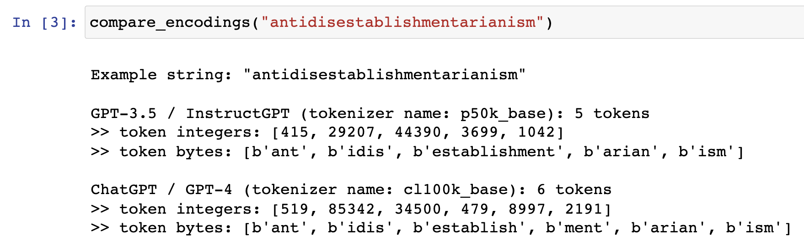
Tokenization in GPT-3+ models
Legend:
Model used
Tokenizer name
# of tokens in example

Slide 23
Tokenization in GPT-3+ models
Legend:
Model used
Tokenizer name
# of tokens in example

Slide 24
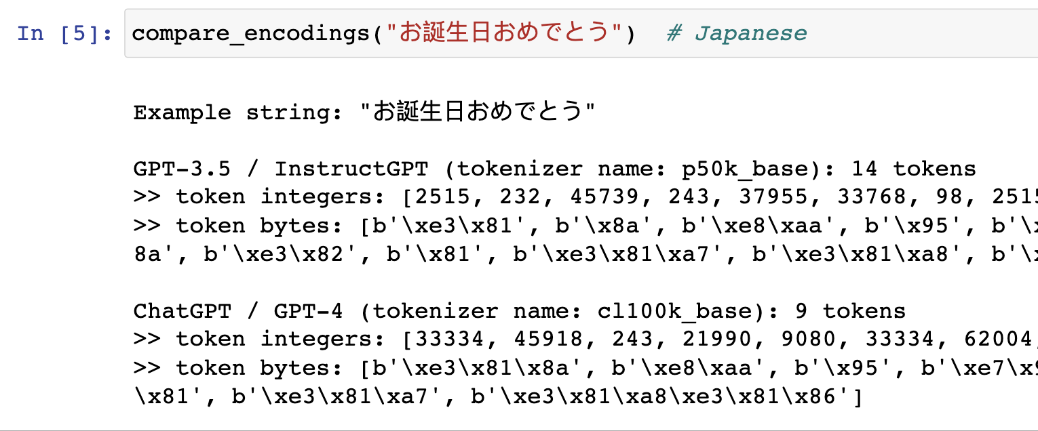
Tokenization in GPT-3+ models
Legend:
Model used
Tokenizer name
# of tokens in example

Slide 25
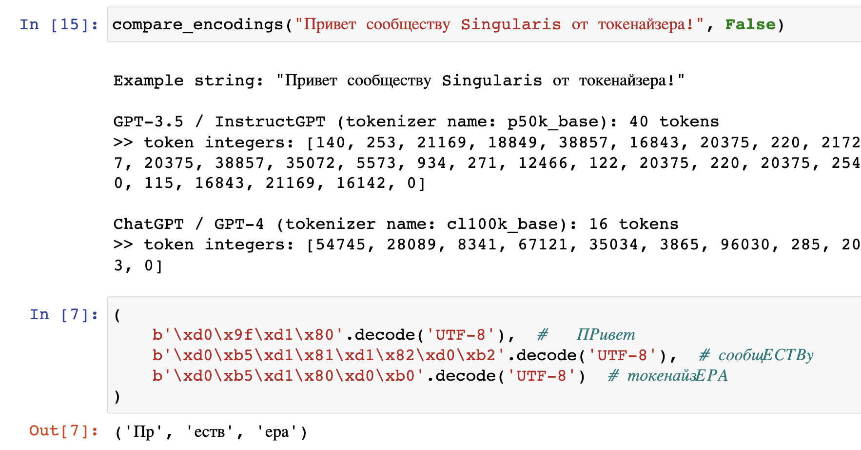
Tokenization in GPT-3+ models
Legend:
Model used
Tokenizer name
# of tokens in example

Slide 26
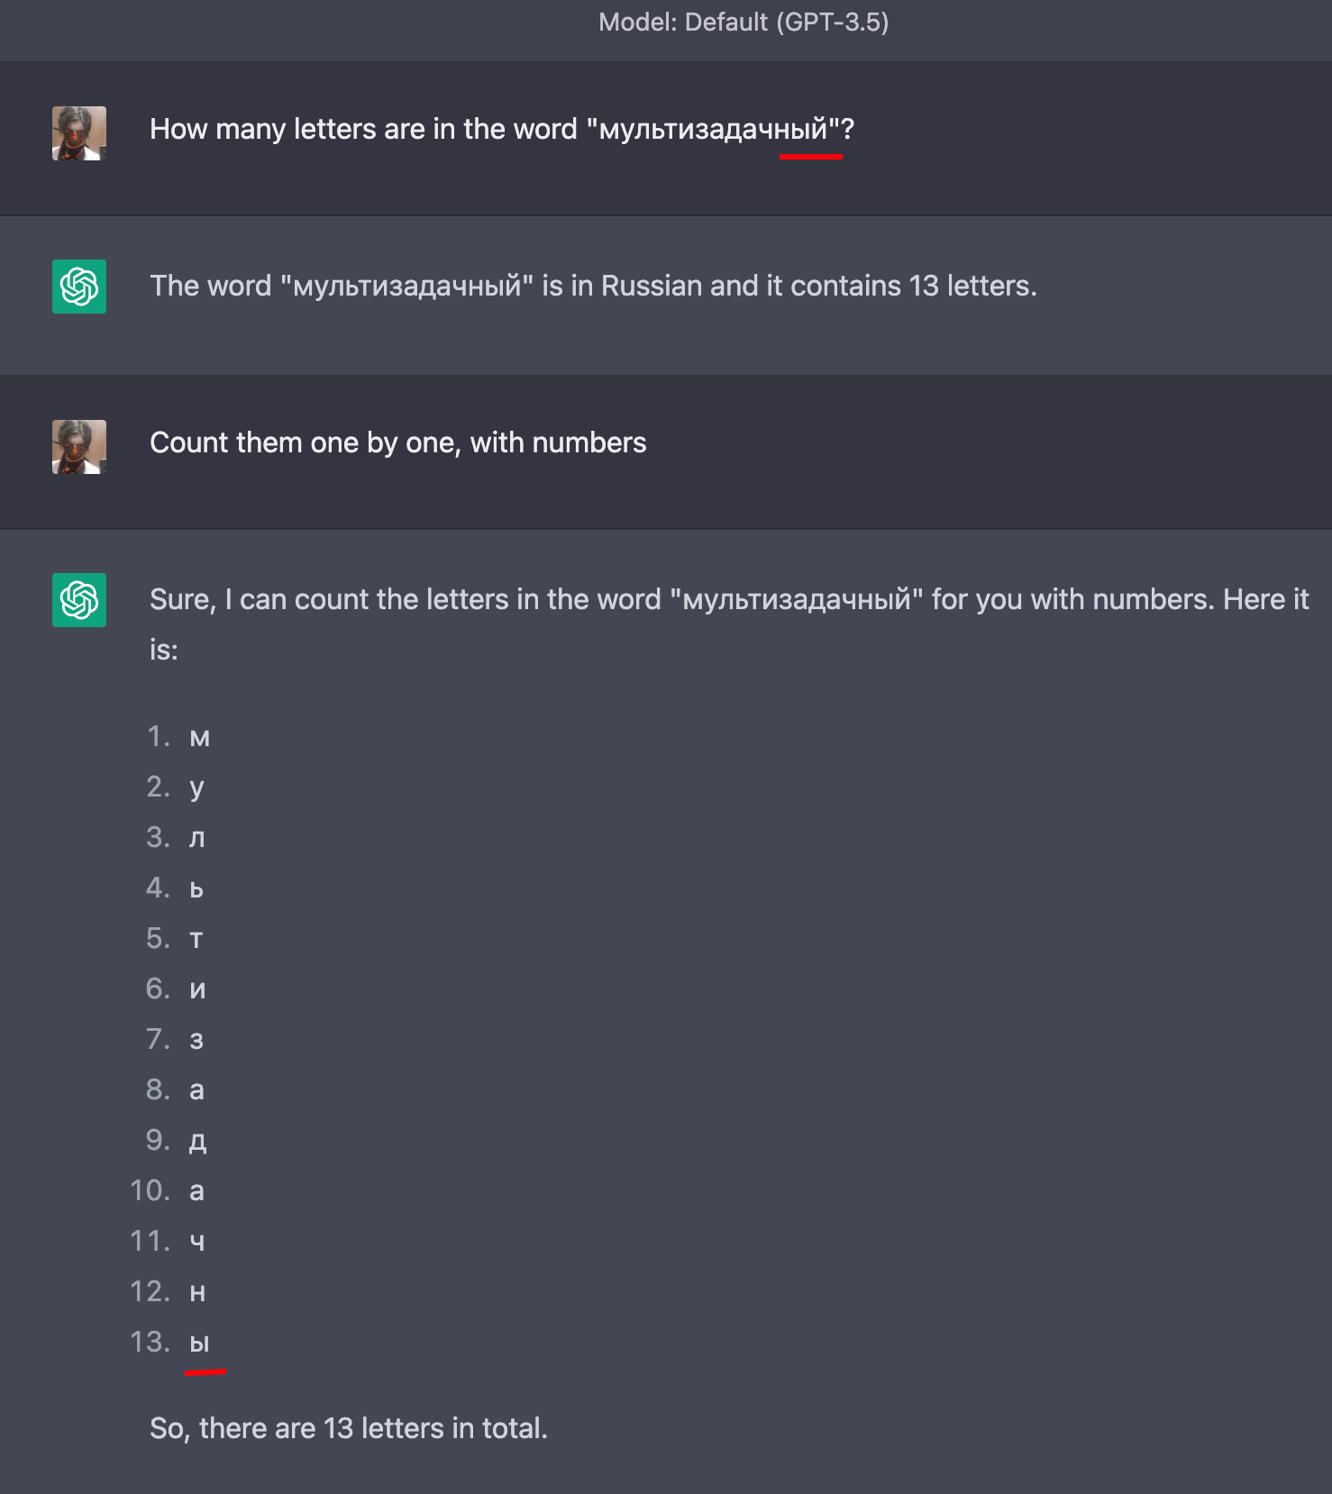
Tokenization in GPT-3+ models
Overcoming the Vocabulary Bottleneck
in Multilingual Masked Language Models: arxiv.org/abs/2301.10472

Slide 27
Token Embedding Matrix
1
2
3
…
6
…
…
…
N
Sequence of Embeddings
height = num. of tokens
token embedding
token embedding
token embedding
width = embedding dimension

Slide 28
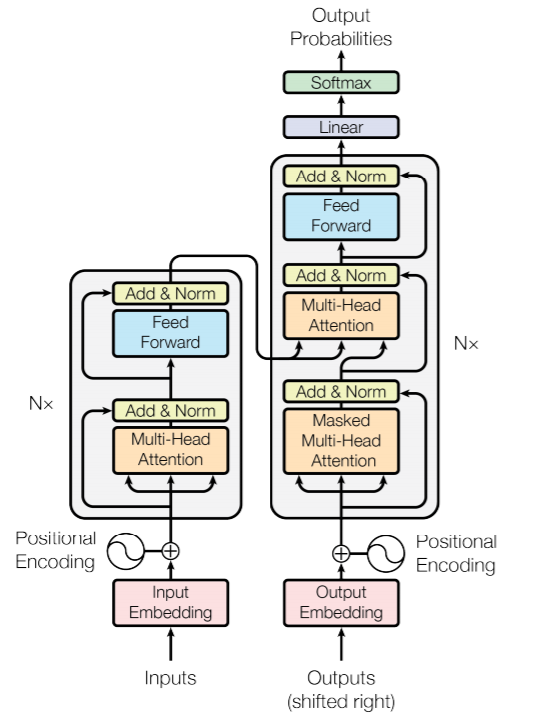
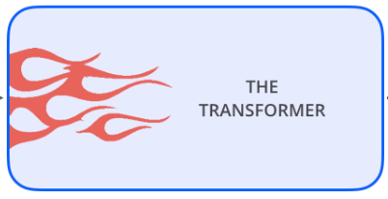
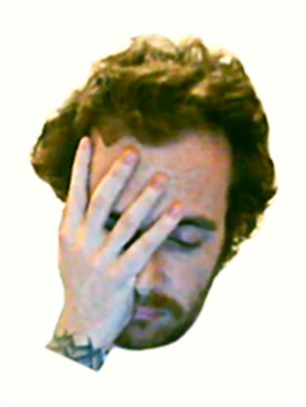

TRANSFORMER
Attention Is All You Need

Slide 29
TRANSFORMER
Attention Is All You Need
Encoder + Decoder​

Slide 30
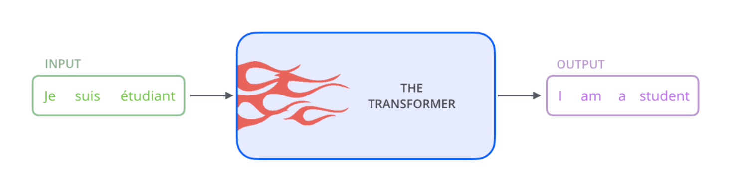
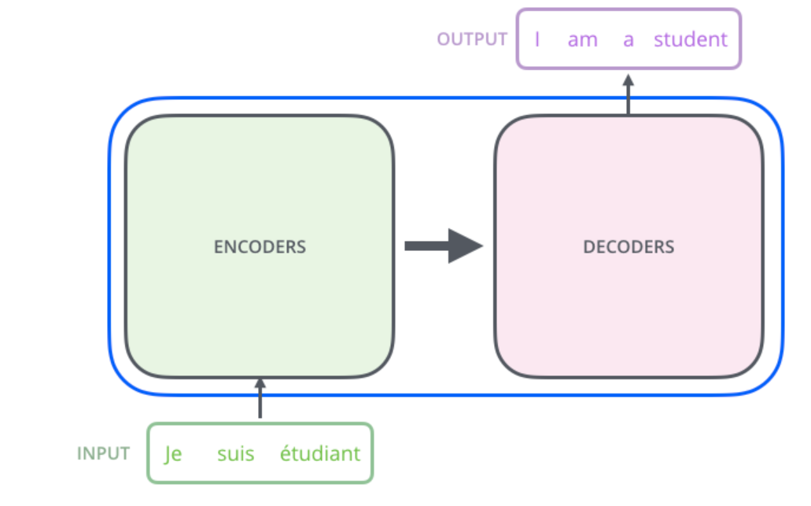

Slide 31
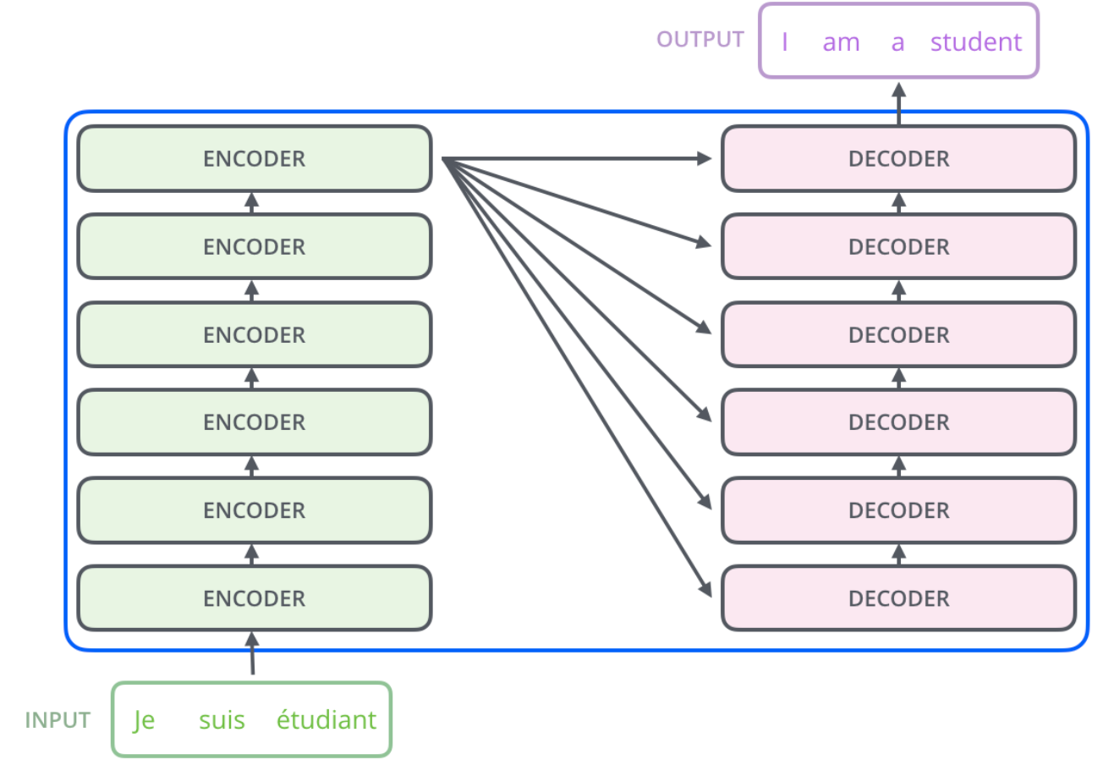

Slide 32
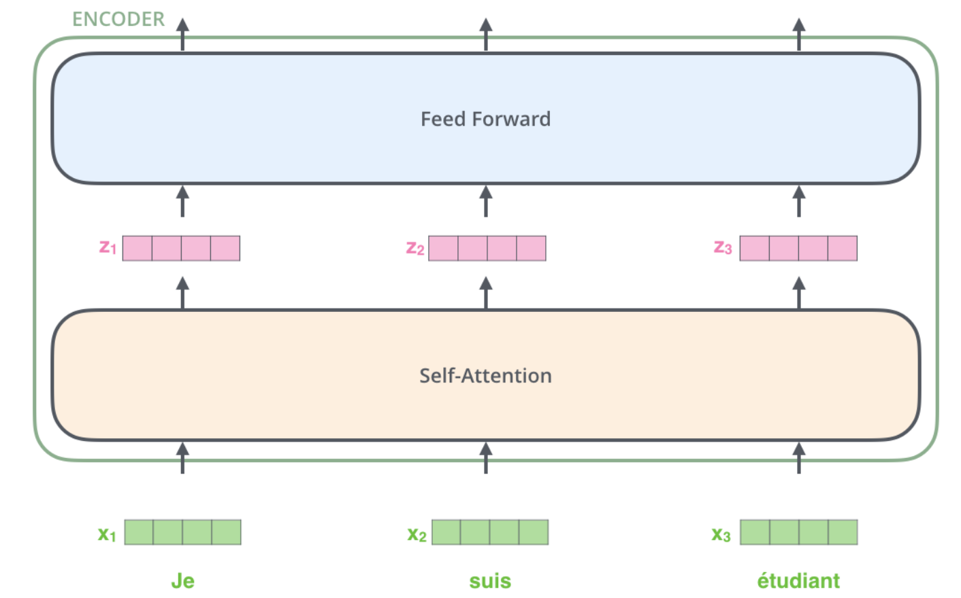
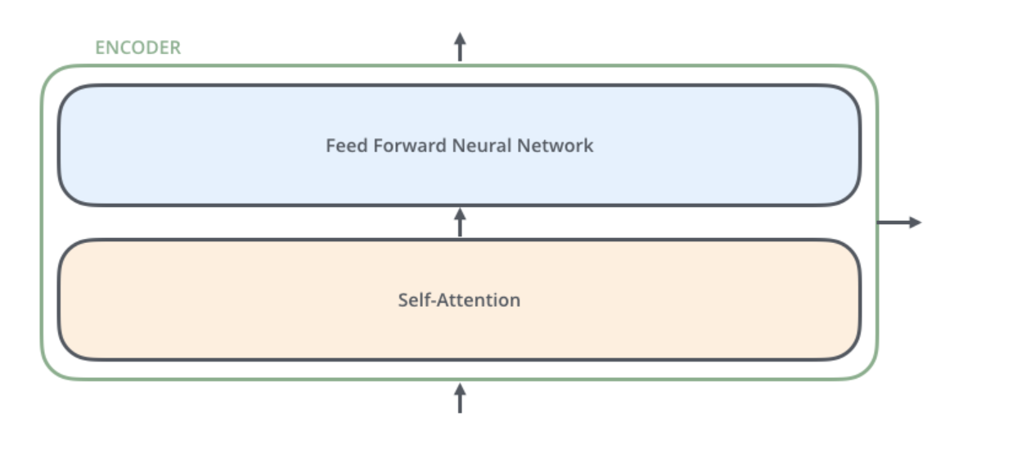
Encoder block
Each Encoder block (module) has the same interface:
N embeddings of size D – as Inputs
N embeddings of size D – as Outputs

Slide 33
Encoder block
Computation
Independently, in parallel
Communication
Process all-at-once, capture
relationships

Slide 34
Feed Forward module in Encoder Block
Feed Forward consists of two Linear Layers: one increases embedding size, another decreases it back:
D_m → D_ff → D_m, where D_ff >> D_m
Typical values (BERT-Base):
D=768
K=3072 (x4)

Slide 35
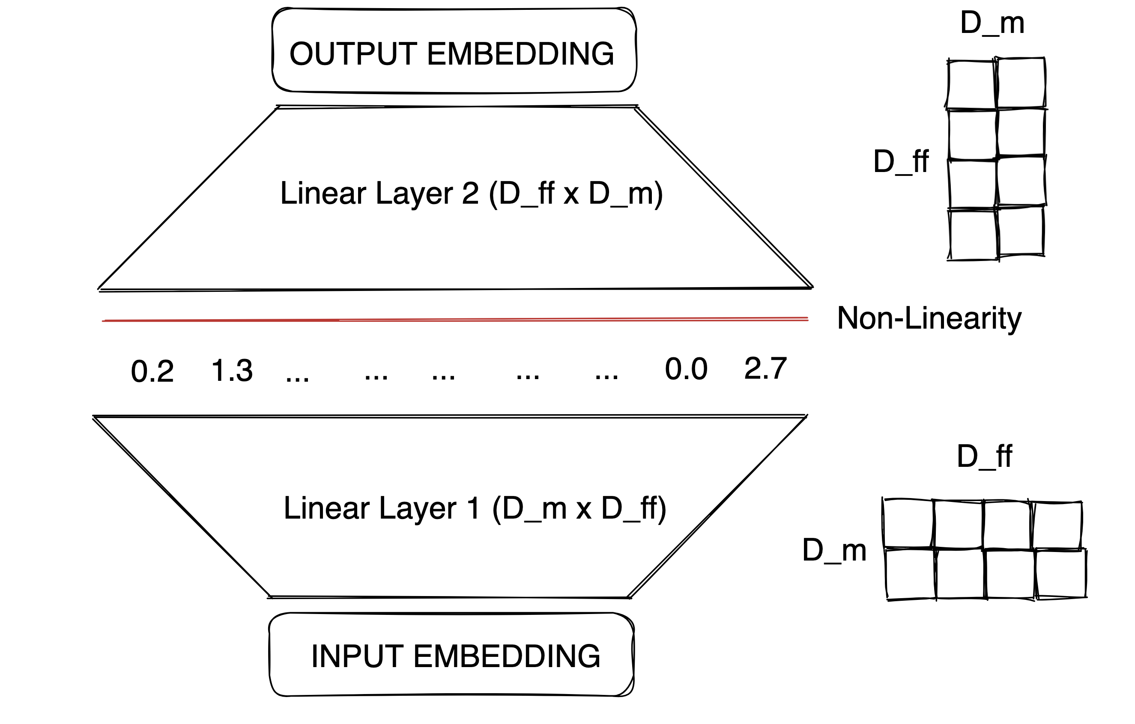
Feed Forward module in Encoder Block
Feed Forward consists of two Linear Layers: one increases embedding size, another decreases it back:
D_m → D_ff → D_m, where D_ff >> D_m
Feed Forward layers constitute ⅔ to 3⁄4 of a transformer model’s parameters
Transformer Feed-Forward Layers Are Key-Value Memories: arxiv.org/abs/2012.14913

Slide 36
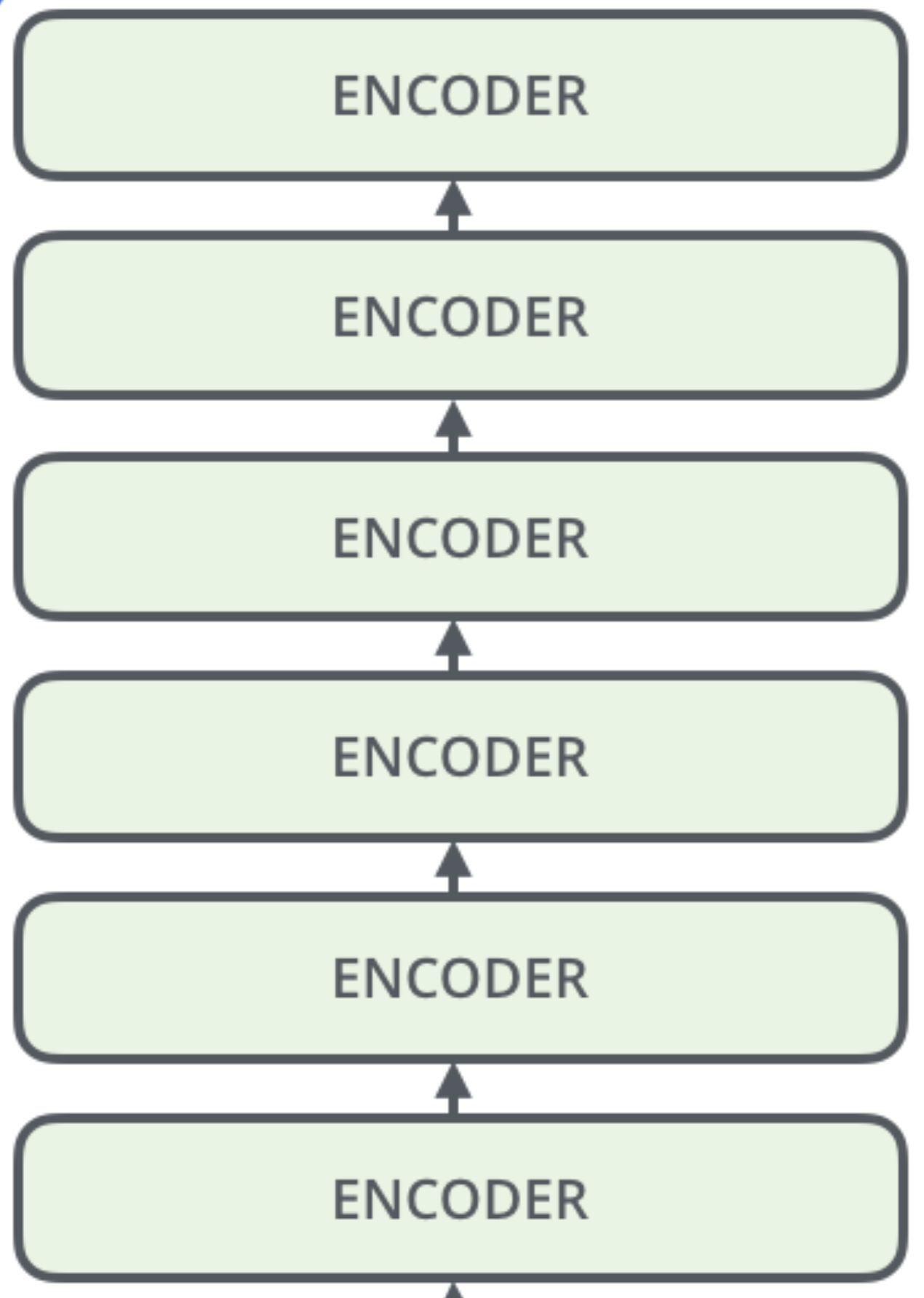
Feed Forward module in Encoder Block
more semantic,
complex patterns
shallower, simpler patterns

Slide 37
Encoder block
Computation
Independently, in parallel
Communication
Process all-at-once, capture
relationships

Slide 38
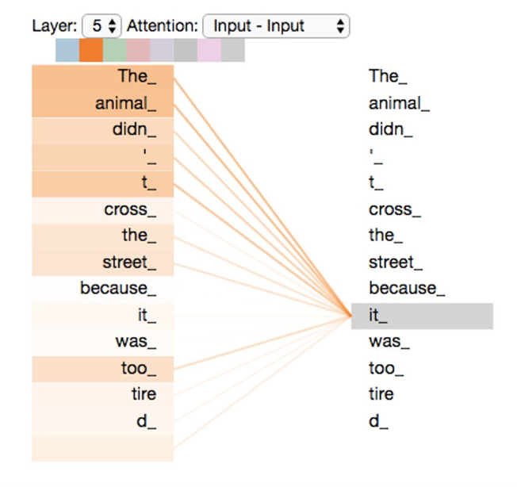
Self-Attention
Intuitively, Self-Attention predicts weights of "dependency" from one word to another, formally extracting word connections in sentences.
These connections are calculated from each token to each other token.

Slide 39
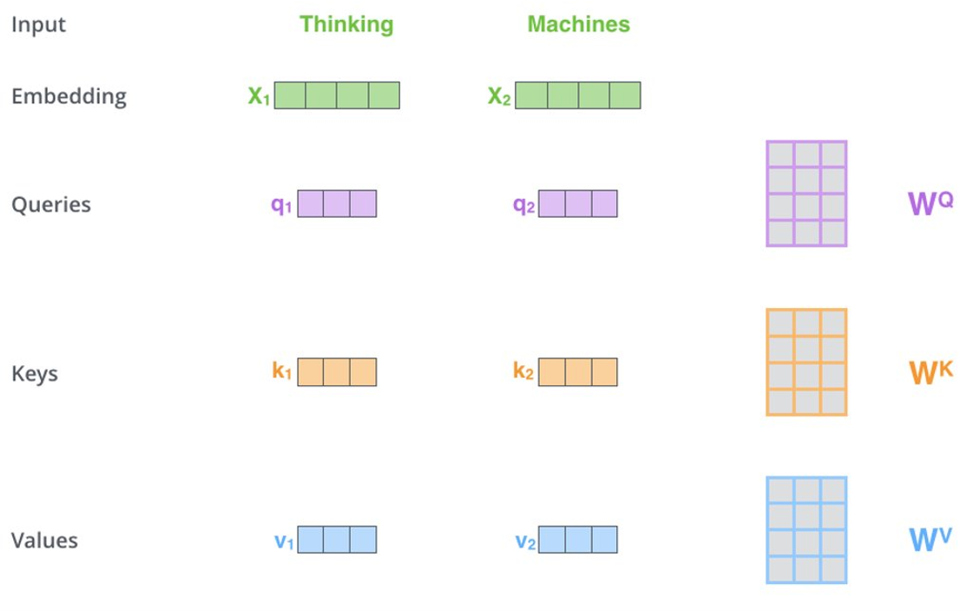
Self-Attention
There are 3 trainable matrices in Self-Attention block:​
Q – query​
K – key​
V – value​
​

Slide 40
Self-Attention
There are 3 trainable matrices in Self-Attention block:​
Q – query​
K – key​
V – value​
​

Slide 41
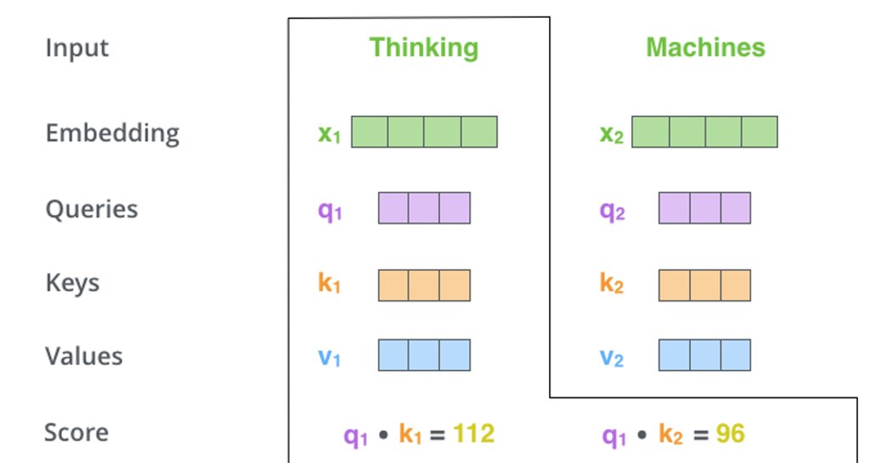
Self-Attention
For each word, dot-product is calculated between the QUERY of the word itself and the KEYS of all words in the sentence
Query – a query from token to its context: what I’m looking for?
Key – a brief meaning of the word in context​: what do I contain?

Slide 42
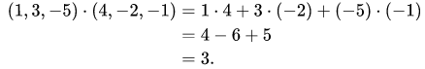
Self-Attention
For each word, dot-product is calculated between the QUERY of the word itself and the KEYS of all words in the sentence
dot-product:
Query – a query from token to its context: what I’m looking for?
Key – a brief meaning of the word in context​: what do I contain?

Slide 43
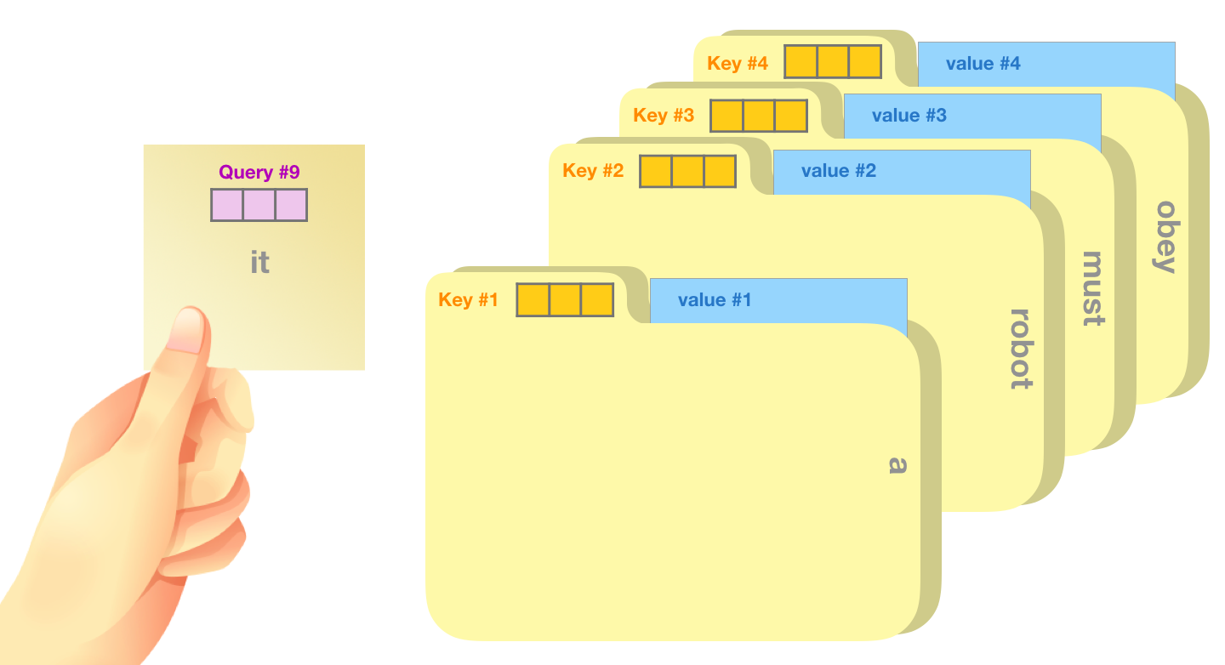
Self-Attention: an alternative view

Slide 44
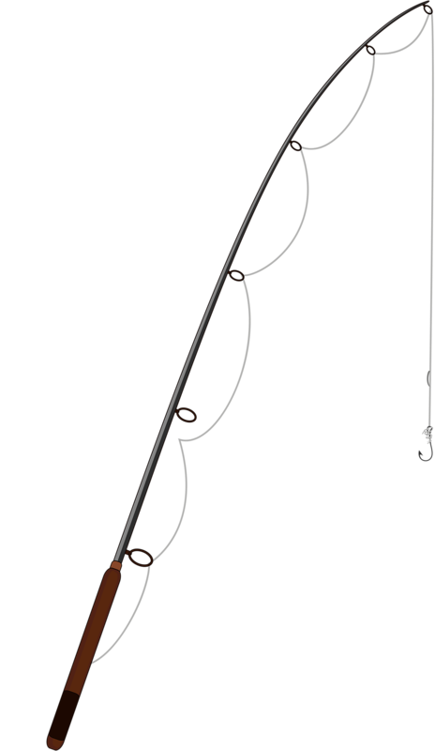
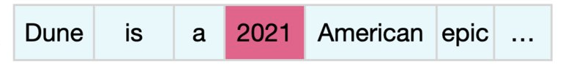
Self-Attention: oversimplified view
query
Hey, I need a date!

Slide 45
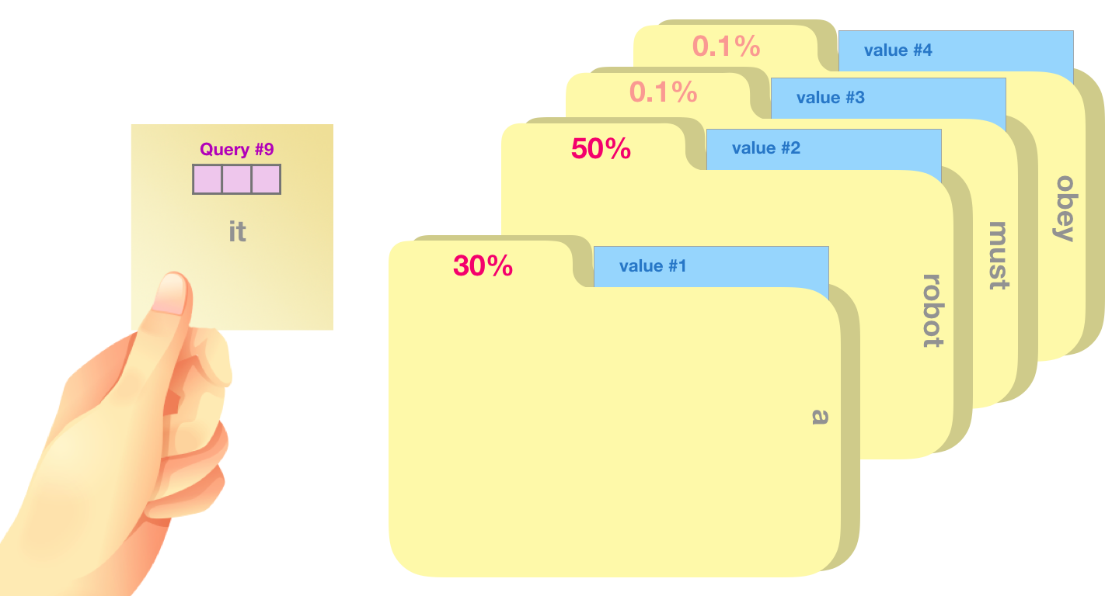
Self-Attention: an alternative view

Slide 46
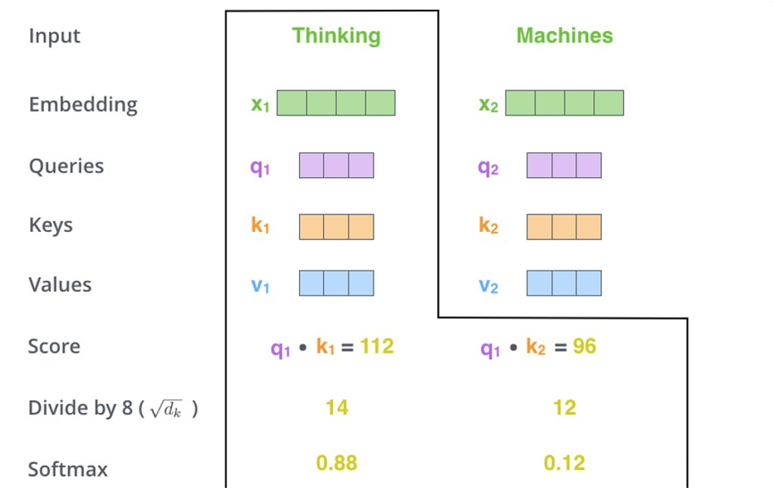
Self-Attention
Query – a query from token to its context: what I’m looking for?
Key – a brief meaning of the word in context​: what do I contain?

Slide 47
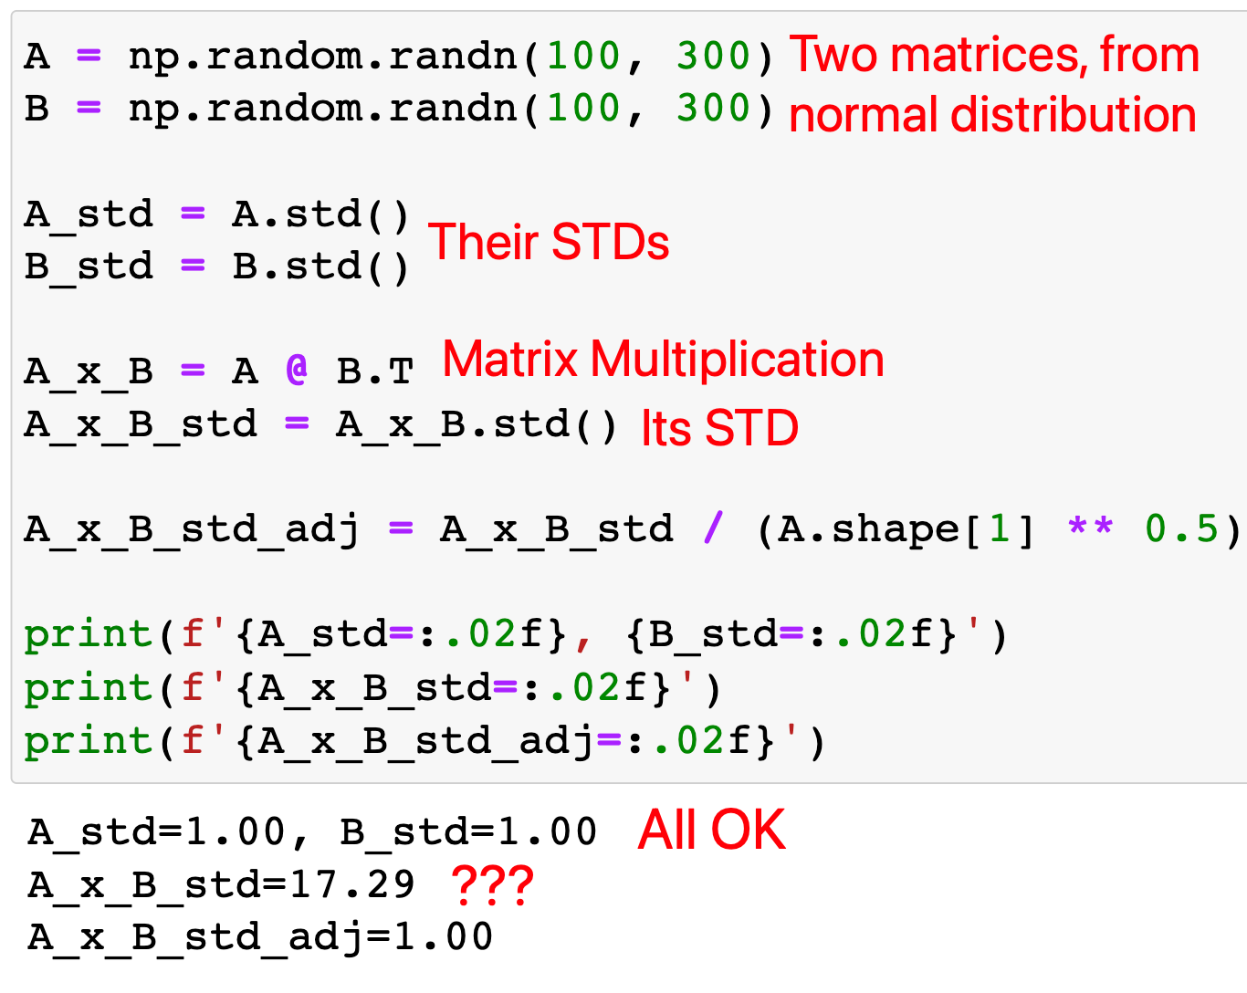
Self-Attention
Query – a query from token to its context: what I’m looking for?
Key – a brief meaning of the word in context​: what do I contain?

Slide 48
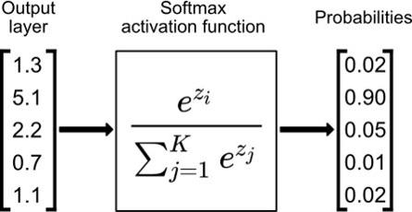
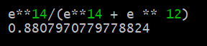
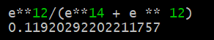
Self-Attention
SoftMax:
Query – a query from token to its context: what I’m looking for?
Key – a brief meaning of the word in context​: what do I contain?

Slide 49
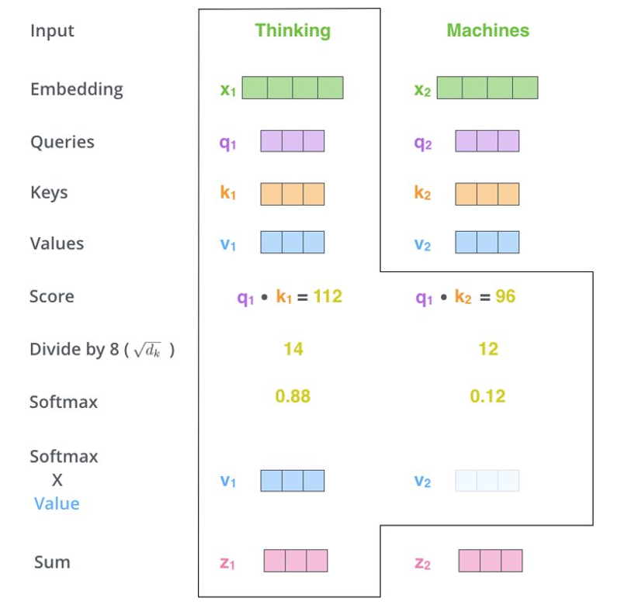
Self-Attention
The final embedding is represented as a weighted sum of value embeddings, proportionate to their dot products.
​
Query – a query from token to its context: what I’m looking for?
Key – a brief meaning of the word in context​: what do I contain?
Value – a full meaning of the word: what I will communicate to you, if you’re interested in me?

Slide 50
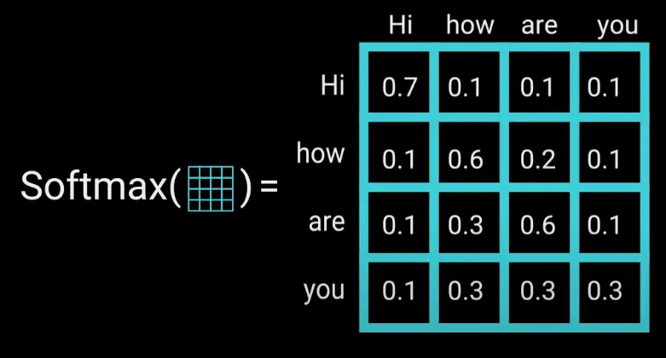
Self-Attention
The final embedding is represented as a weighted sum of value embeddings, proportionate to their dot products.
​
The computational complexity is O(n^2), where n is the number of input tokens, as the weight matrix is calculated from each word to every other word.
Query – a query from token to its context: what I’m looking for?
Key – a brief meaning of the word in context​: what do I contain?
Value – a full meaning of the word: what I will communicate to you, if you’re interested in me?

Slide 51
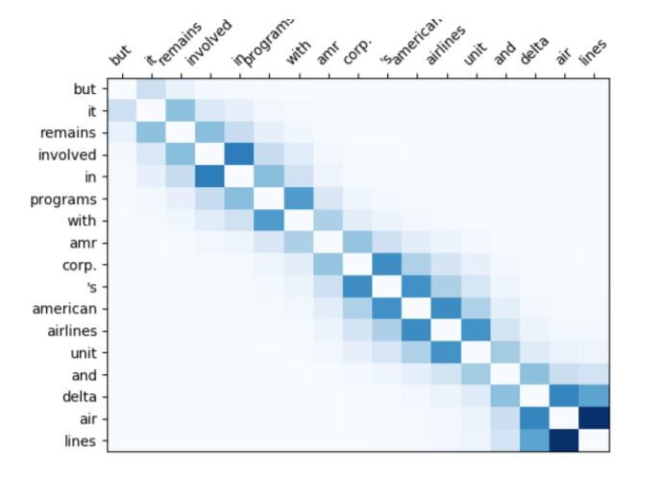
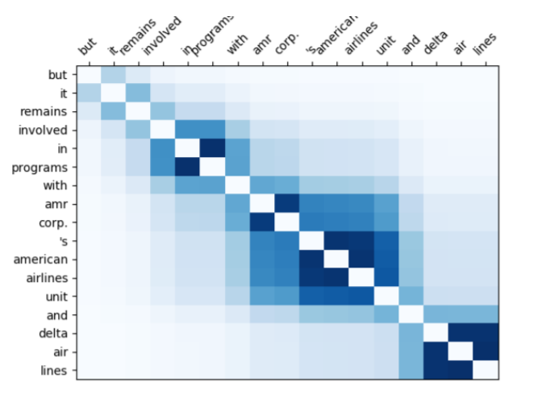
Attention Matrix

Slide 52
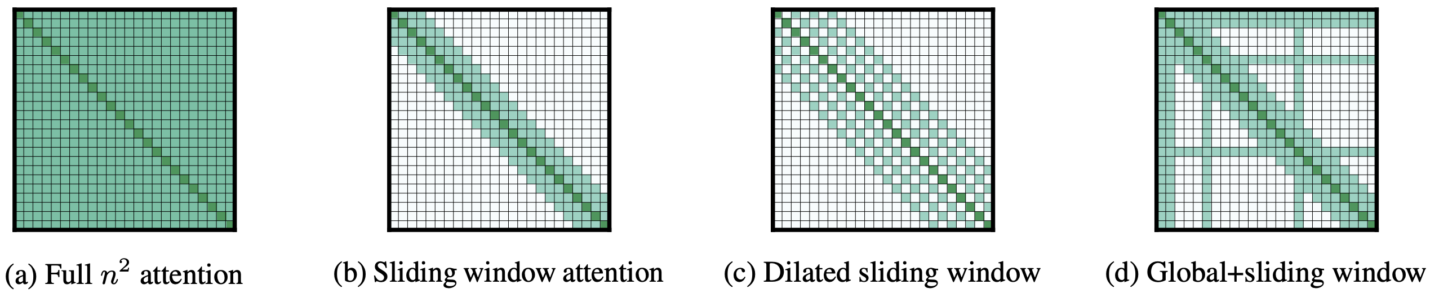
Attention Matrix
(Used in GPT-3) Generating Long Sequences with Sparse Transformers: arxiv.org/abs/1904.10509
Reformer: The Efficient Transformer: arxiv.org/abs/2001.04451
Longformer: The Long-Document Transformer: arxiv.org/abs/2004.05150
Linformer: Self-Attention with Linear Complexity: arxiv.org/abs/2006.04768
Rethinking Attention with Performers: arxiv.org/abs/2009.14794

Slide 53
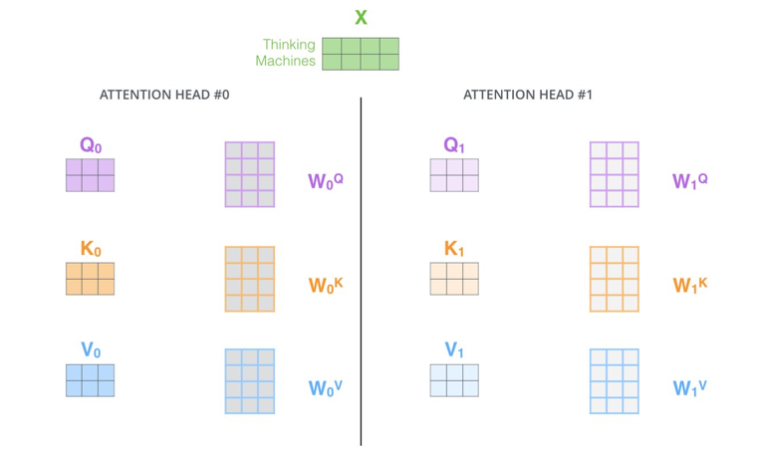
MultiHead Self-Attention (MSA)

Slide 54
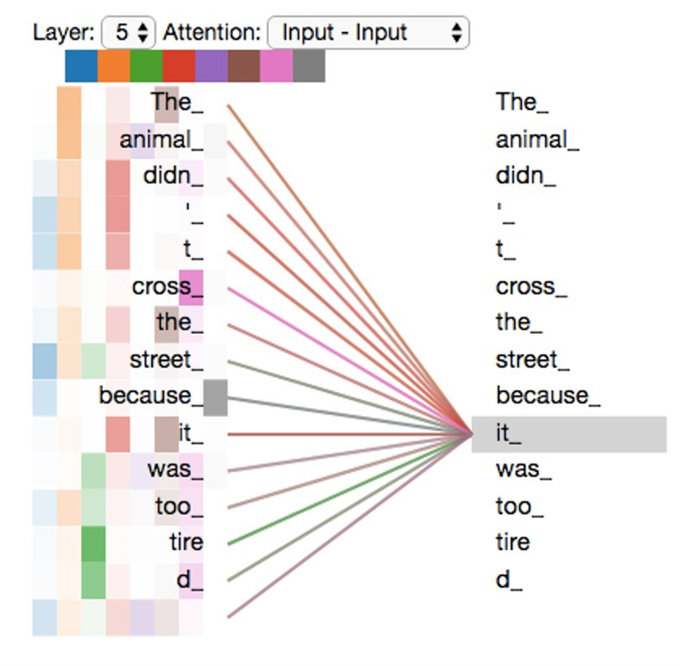
MultiHead Self-Attention (MSA)
We can add many different triplets of attention matrices (there are 8 of them in BERT-base, for example)​​ ​ Each is looking for its own signal or pattern

Slide 55
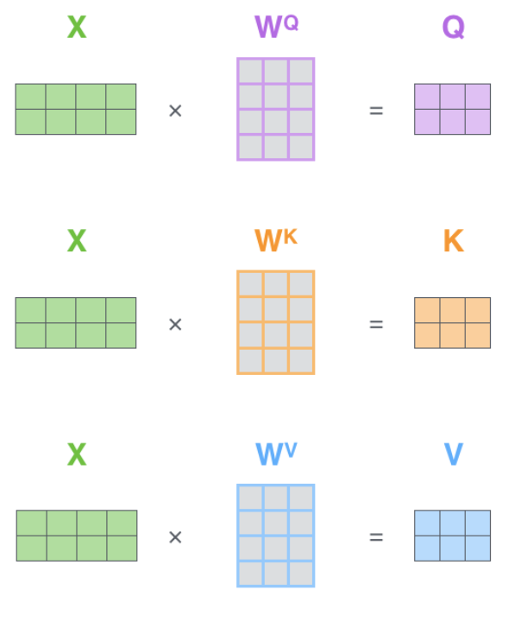
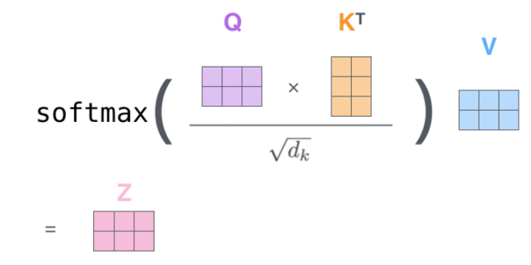
SA matrix form

Slide 56
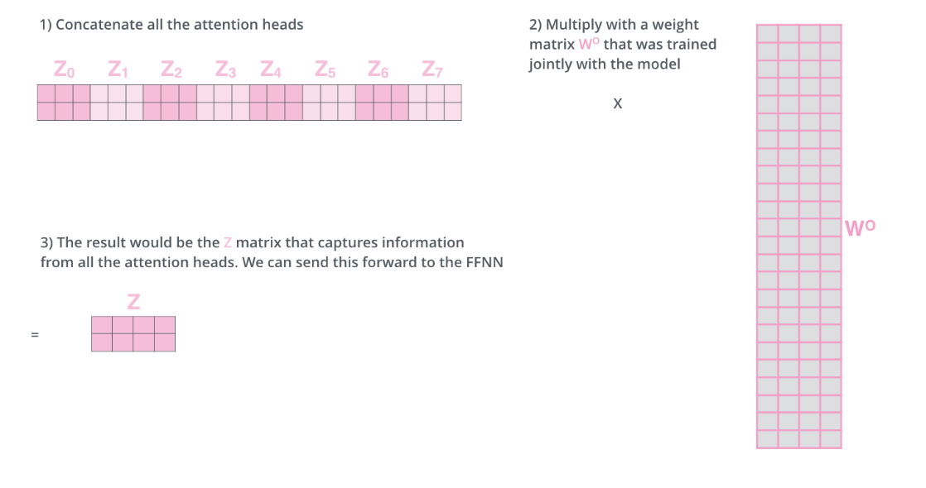

Slide 57
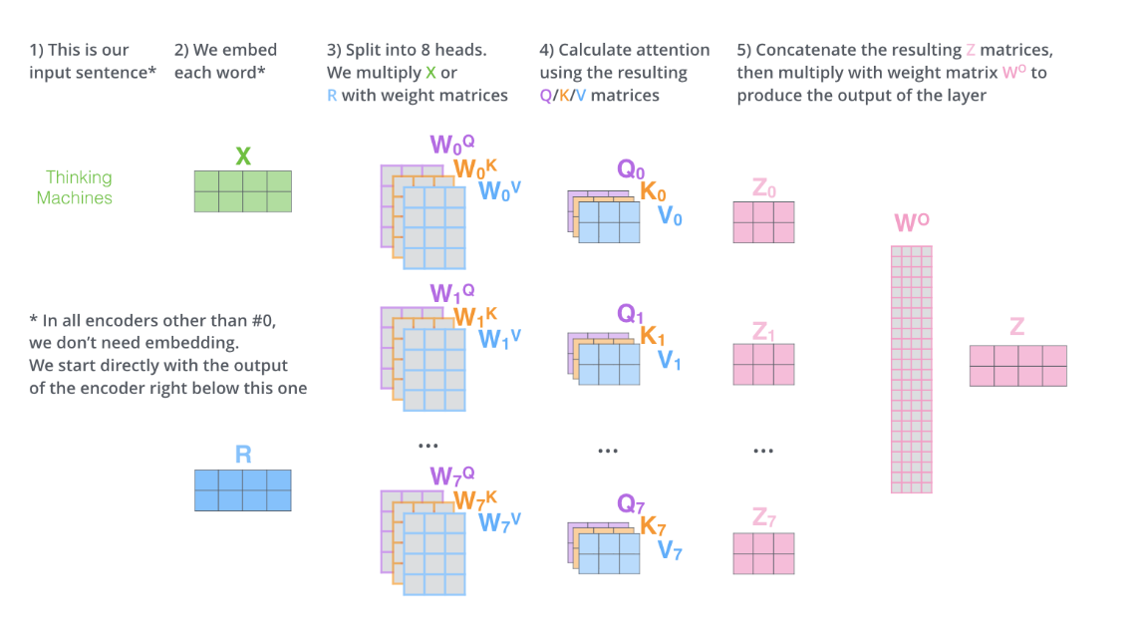

Slide 61
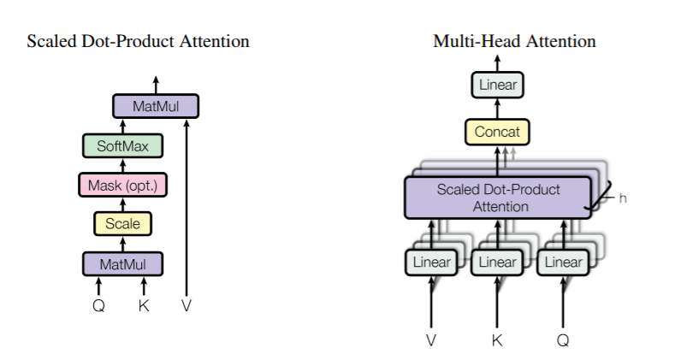
Meanwhile in the paper…

Slide 62

You can play with it online!
Link

Slide 63

And here's a problem...

Slide 64

And here's a problem...
It limits the context length
These embeddings are hard to train

Slide 65


Pos Encoding

Slide 66
Pos Encoding
Self-Attention with Relative Position Representations:
arxiv.org/abs/1803.02155
RoFormer: Enhanced Transformer with Rotary Position Embedding:
arxiv.org/abs/2104.09864

Slide 67


And other optimization tricks
Layer-Norm
Residuals

Slide 68

Post LN vs Pre LN
On Layer Normalization in Transformer Architecture: arxiv.org/abs/2002.04745

Slide 69

Residuals
X + F(X)

Slide 70

Residuals
X + F(X)
LayerNorm
A * (X – mean_X) / (std_X) + b

Slide 71

Encoder VS Decoder

Slide 72
Cross-Attention
Encoder
Decoder

Slide 73

Cross-Attention
Encoder
Decoder

Slide 74

Cross-Attention
Encoder
Decoder
Attention Scores

Slide 75

Cross-Attention
Encoder
Decoder
Attention Scores

Slide 76
Cross-Attention
Encoder
Decoder
Why "cross", not "self"?

Slide 77

Gifs ?
Encoder-Decoder Interaction

Slide 78


Slide 79

One more thing...

Slide 80

Masks Off!
Problem:
We can't use information from the "future" tokens

Slide 81

Masks Off!
Zero attention
Problem:
We can't use information from the "future" tokens

Slide 82

Masks Off!
all tokens (left + right)
up to and including

Slide 83

Masks Off!
all tokens (left + right)
up to and including

Slide 84


Slide 85


Train Loss

Slide 86

Train Loss

Slide 87

BERT vs GPT
Transformer (invented for translation task):

Slide 88

BERT vs GPT
Transformer (invented for translation task):
Decoder-only model (without Cross-Attn)

Slide 89

BERT vs GPT
Transformer (invented for translation task):
Encoder-only model
Decoder-only model
(without Cross-Attn)

Slide 90


BERT Training task: MLM
Tain the model using MLM: Masked Language Modeling​
​

Slide 91
BERT Training task: MLM
Tain the model using MLM: Masked Language Modeling​
​
"Training the language model in BERT is done by predicting 15% of the tokens in the input, that were randomly picked. These tokens are pre-processed as follows — ​
80% are replaced with a “[MASK]” token, 10% with a random word, ​
and 10% use the original word."​

Slide 92

BERT Training task: NSP
Train the model using NSP – Next Sentence Prediction (a simple binary classifier)

Slide 93
BERT Training task: NSP
Train the model using NSP – Next Sentence Prediction (a simple binary classifier)
Two sentences are concatenated using special [SEP]-token; train additional Segement Embeddings

Slide 94
BERT Training task: NSP
Train the model using NSP – Next Sentence Prediction (a simple binary classifier)
Two sentences are concatenated using special [SEP]-token; train additional Segement Embeddings
Segement Embeddings can encode meta-information, such as Geo, web-domains, etc.

Slide 95

Text Representation in BERT
most common co-occurrences (tokens) and their embeddings
+ positional embeddings
+ segment embeddings

Slide 96

Decoder Models Training Objectives
Unifying Language Learning Paradigms: arxiv.org/abs/2205.05131
Multitask Prompted Training Enables Zero-Shot Task Generalization: arxiv.org/abs/2110.08207

Slide 97
Why transformers are THIS good and popular?
One-size-fits-all
Very Strong Baseline
Transfer Learning Capabilities
Easy-to-Scale

Slide 98
Why transformers are THIS good and popular?
One-size-fits-all
Very Strong Baseline
Transfer Learning Capabilities
Easy-to-Scale
More Data = Better Model
Much Faster Training (no recursion)
Software/Hardware optimizations

Slide 99

Why transformers are THIS good and popular?
One-size-fits-all
Very Strong Baseline
Transfer Learning Capabilities
Easy-to-Scale
More Data = Better Model
Much Faster Training (no recursion)
Software/Hardware optimizations

Slide 100
Тут вообще кто-то читает? АЛЁ!
Directed by
IGOR D. KOTENKOV
Текст слайда

